Slide 1


Slide 2




About the University of the Peloponnese
A modern, multidisciplinary, regional, and multi-campus university
Established in 2000, it accepted its first students in 2002
Developed in Tripolis, Corinth, Nafplio, Sparta, Kalamata, and Patras
Comprises 9 Schools and 22 Departments
It offers studies in all cycles of learning: undergraduate, postgraduate, and Doctoral as well as Life Long Learning
More than 20.000 students (1st, 2nd και 3rd Cycle of Studies)

Slide 3


Vision - Mission
Optimal administrative structures and practices
Developing interdisciplinarity within the University and
with other institutions in Greece and abroad
Integration of ICT (Information and Communication Technologies)
Close cooperation with local
and regional authorities
Internationalization of research and teaching
Generating, disseminating, and promoting high-quality teaching and research
Contributing to
society’s cultural and
economic progress
through knowledge-based innovation
Respecting
and promoting
diversity and multiculturalism
Establishing links with alumni and external stakeholders

Slide 4





Facts and Figures
45
350
22.420
undergraduate students
members of Academic Staff
1.706
Postgraduate Programs
175
(6 in English language and 8 in collaboration with Greek and foreign universities)
postgraduate students
527
members of Administrative Staff
doctoral students

Slide 5

Schools &
Departments
School of Economics and Technology (Tripolis)
School of Humanities an Cultural Studies (Kalamata)
School of Social and Political Sciences (Corinth)
School of Fine Arts (Nafplio)
School of Human Movement and Quality of Life Science (Sparta)
Department of Economics
Department of History, Archaeology and Cultural Resources Management
Department of Social and Education Policy
Department of Theatre Studies
Department of Sport Management
Department of Philology
Department of Political Science and International Relations
Department of Informatics and Telecommunications
Department of Management Science And Technology
Department of Digital Systems
Department of Performing and Digital Arts
UNDERGRADUATE STUDIES

Slide 6
Schools &
Departments
School of Management (Kalamata)
School of Health Sciences (Tripolis)
School of Agriculture and Food (Kalamata)
School of Engineering (Patras)
Department of Accounting and Finance
Department of Nursing
Department of Agriculture
Department of Electrical and Computer Engineering
Department of Business and Organization Administration
Department of Physiotherapy
Department of Speech and Language Therapy
Department of Nutrition and Dietetics
Department of Food Science and Technology
Department of Mechanical Engineering
Department of Civil Engineering
UNDERGRADUATE STUDIES

Slide 7



Scientific Publications (2010-14) (world average 1)
Fields of Science | Publications Impact Indicator | National ranking
Natural Sciences | 2.77 | 1st position
Engineering & Technology | 1.11 | 5th position
Social Sciences | 0.94 | 5th position
Reference: Sachini E, Malliou N., Chrysomallidis C., Karabekios N., (2016), Greek Scientific Publications 2000-2014: A Bibliometric Analysis of Greek Publications in International Scientific Journals, Web of Science, National Documentation Centre,(http://report06.metrics.ekt.gr/el/institutes-profile)

Slide 8






Research
95 internationally
funded projects
> 200 competitive research projects are in progress
85 nationally
funded projects
(participation in H2020, Erasmus+, etc.)

Slide 9


UoP’s extrovert orientation
Collaboration with 30 national
and 3 international
organizations
Collaboration with
8 national and
13 foreign Universities
(Ministries, Regions, Municipalities, Chambers, Institutes, Research centres, Charity organizations, etc.)
Social Contribution via
The collaboration with the Region of the Peloponnese
Staff, students, and alumni involvement in a wide range of activities

Slide 10

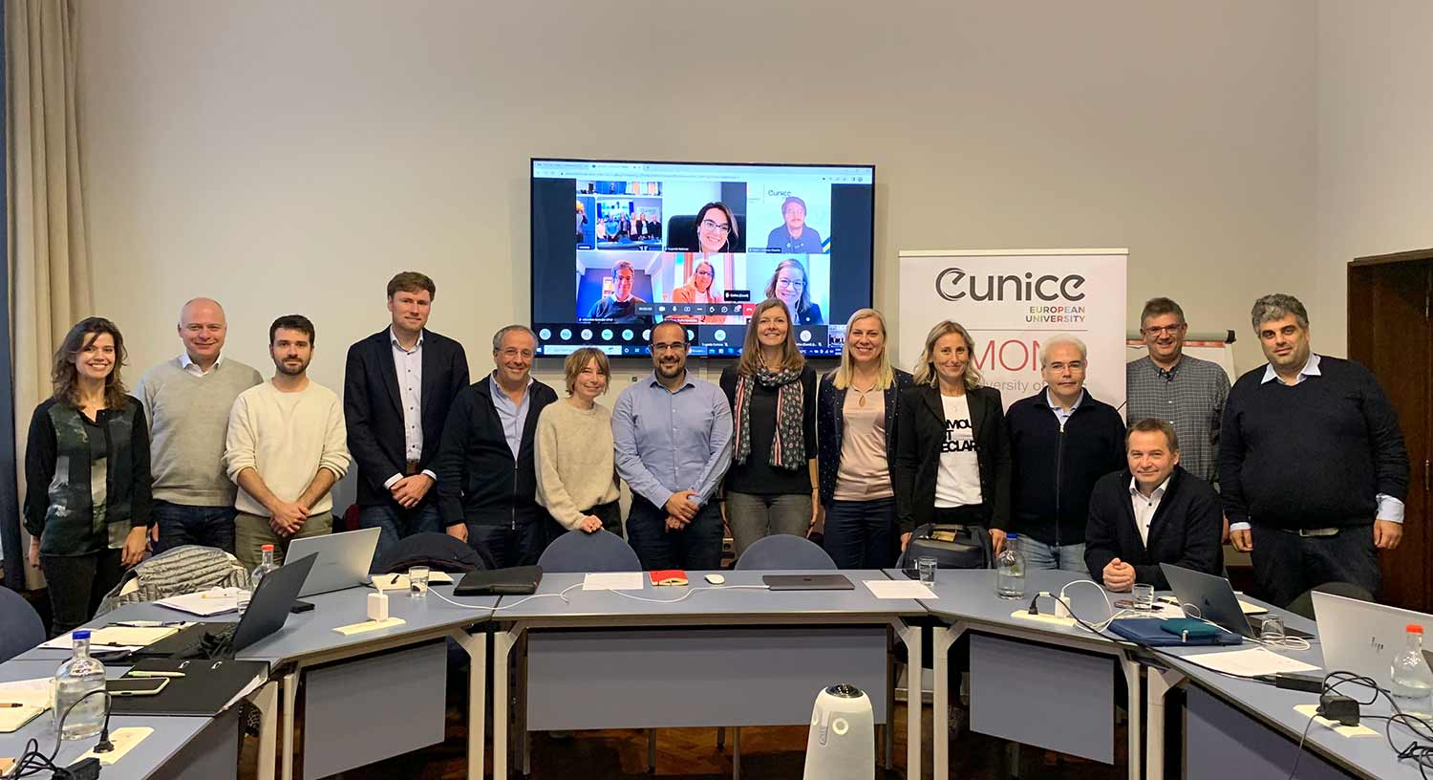
Member of EUNICE https://eunice-university.eu/
Poznan University of Technology (Poland coordinator)
Brandenburg University of Technology (Germany)
University of Cantabria (Spain)
University of Mons (Belgium)
University of Catania (Italy)
Universite Polytechnique HAUTS-DE-FRANCE (France)
University of Vaasa (Finland)
The Polytechnic Institute of Viseu (Portugal)
University of Karlstad (Sweden)
University of the Peloponnese (Greece)
The Department of Informatics and Telecommunications of the University of the Peloponnese in collaboration with CERN (European Organization for Nuclear Research)

Slide 11
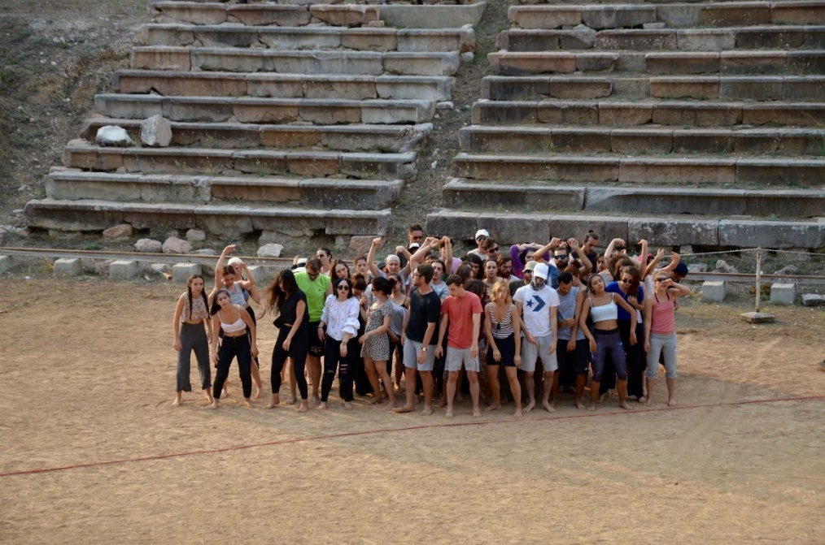

Stellar collaborations
The Epidaurus Lyceum is an Athens & Epidaurus Festival educational programme and is realized under the auspices and the support of the Hellenic Ministry of Culture and Sports and in collaboration with the Department of Theatre Studies, School of Fine Arts, University of the Peloponnese.
The Department of Informatics and Telecommunications of the University of the Peloponnese in collaboration with CERN (European Organization for Nuclear Research)

Slide 12


Erasmus+ and UoP
250 Interinstitutional Agreements in 26 countries
Students’
Mobility
Teaching Staff
Mobility
Administrative
Staff Mobility
306 students have studied and 221 have trained abroad
171 students have studied and 99 have trained in Greece
103 members of teaching staff have gained new teaching experiences in an international context and 119 came to the University of the Peloponnese
89 members of administrative staff have undertaken learning and/or professional experience in another countries and 66 came to the University of the Peloponnese.

Slide 13


External accreditation
results (2018)
Accredited Quality Assurance

Slide 14

UoP Study Guide

Slide 15
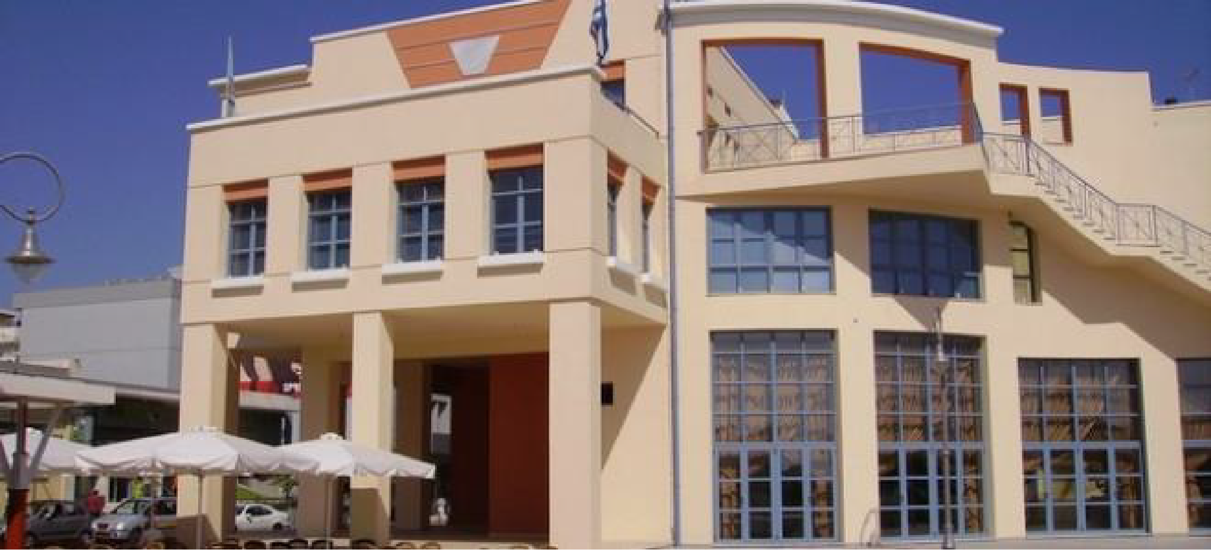
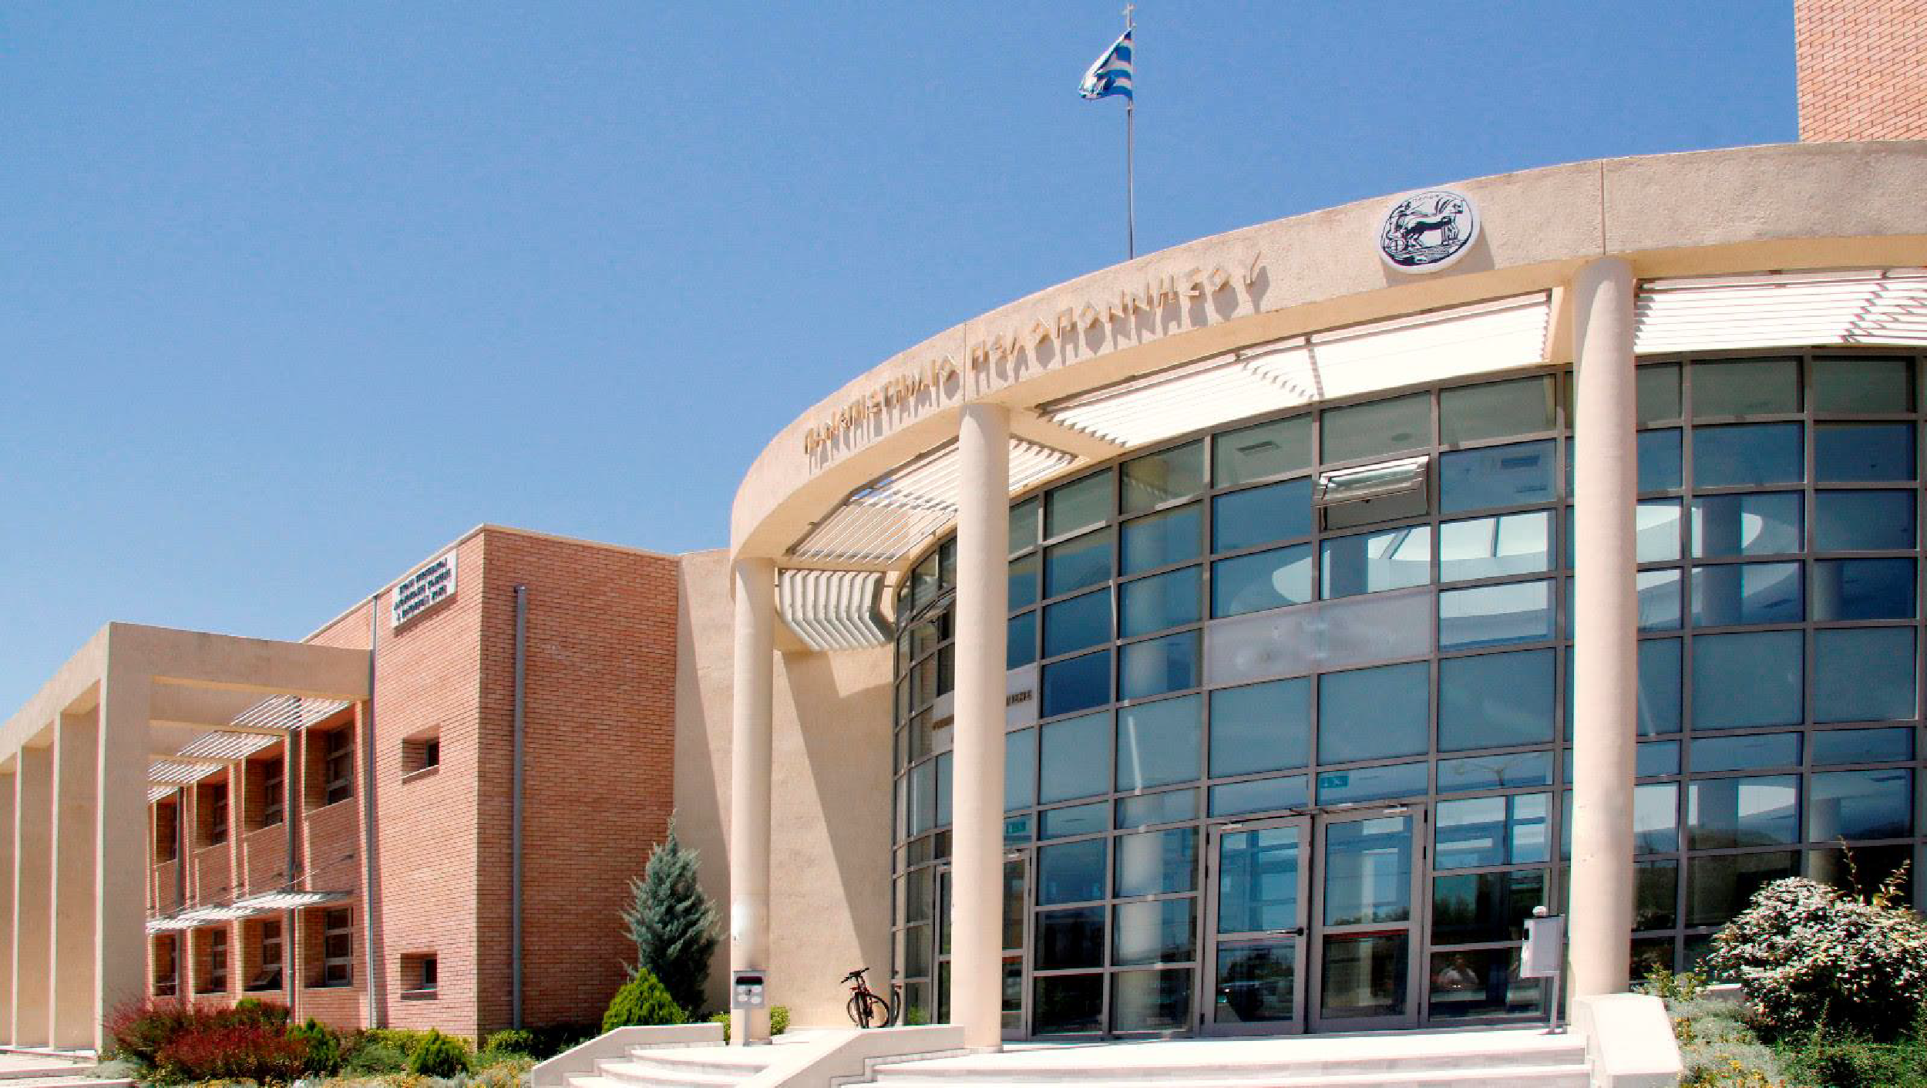

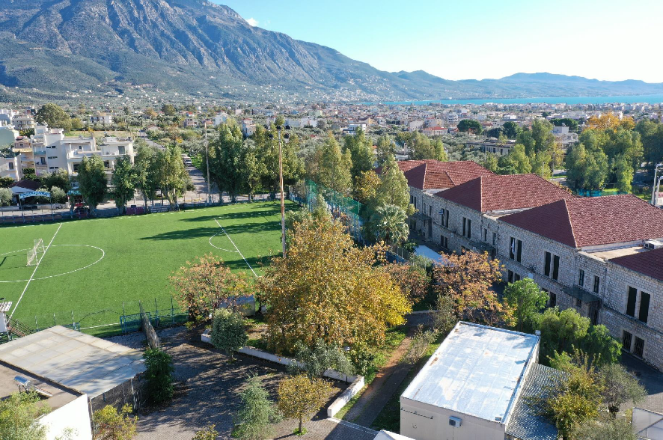
UoP in images

Slide 16





Social Media & UoP
The University of the Peloponnese has a social media presence on Facebook, Twitter, Instagram, and YouTube
@uopgr
@uop.gr
@uopgr
@Γραφείο Δημοσίων Σχέσεων UoP

